Slide 1
Math 769: Statistical Learning

Slide 2
Maximum Likelihood Inference
Shahrzad Jamshidi, PhD

Slide 3
Last Time
In the last module, we discussed in detail the challenge of balancing the bias-variance tradeoff.
AIC, BIC, and MDL were metrics one could use to perform model selection. All three balance fit with model complexity.
We also discussed VC Dimension, Cross Validation, and Bootstrapping as methods for estimating the prediction error or the expected prediction error when the dataset is too small to allow for a testing set.

Slide 4
Objectives
Define maximum likelihood inference, maximum likelihood estimator, and related terms.
Describe the process of maximum likelihood inference.
Compute two examples of maximum likelihood inference, one of which is OLS linear regression.

Slide 5
Likelihood
Likelihood is the probability of observing the given data under a particular model.
a fundamental concept in statistics,
represents the probability of observing the data given a set of parameters in a statistical model
unlike probability, likelihood varies with the model's parameters

Slide 6
Maximum Likelihood Inference
Maximum likelihood inference is a method to estimate model parameters by maximizing the log-likelihood function.
In other words, we construct the model that maximizes the likelihood of getting our dataset.

Slide 7
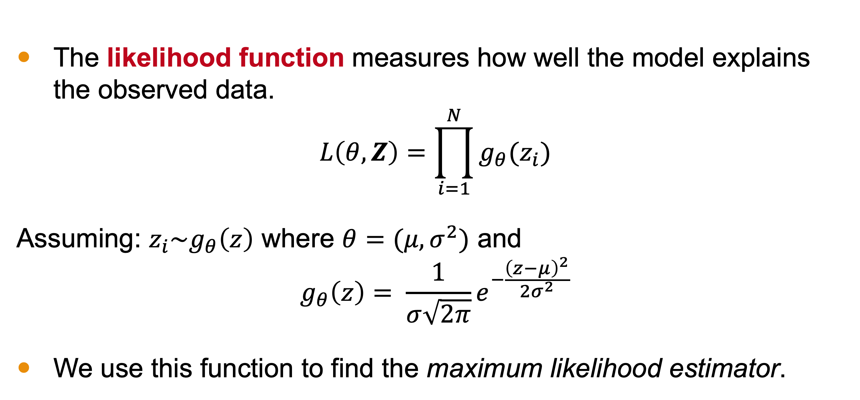
Likelihood Function
The likelihood function measures how well the model explains the observed data.
$$L\left(θ,Z\right)=\prod_{i=1}^{N}{g_{θ}(z_{i})}$$
Assuming: $z_{i}\sim g_{θ}\left(z\right)$ where $θ=(μ,σ^{2})$ and
$$g_{θ}\left(z\right)= \frac{1}{σ\sqrt{2π}}e^{−\frac{{\left(z−μ\right)}^{2}}{2σ^{2}}}$$
We use this function to find the maximum likelihood estimator.

Slide 8
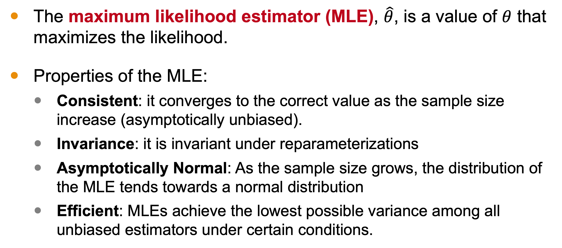
Maximum Likelihood Estimator (MLE)
The maximum likelihood estimator (MLE), $\hat{θ}$, is a value of $θ$ that maximizes the likelihood.
Properties of the MLE:
Consistent: it converges to the correct value as the sample size increase (asymptotically unbiased).
Invariance: it is invariant under reparameterizations
Asymptotically Normal: As the sample size grows, the distribution of the MLE tends towards a normal distribution
Efficient: MLEs achieve the lowest possible variance among all unbiased estimators under certain conditions.

Slide 9
Calculating the MLE
The MLI process typically involves:
Defining the likelihood function for the model.
Using calculus (differentiation) to find the MLE.

Slide 10
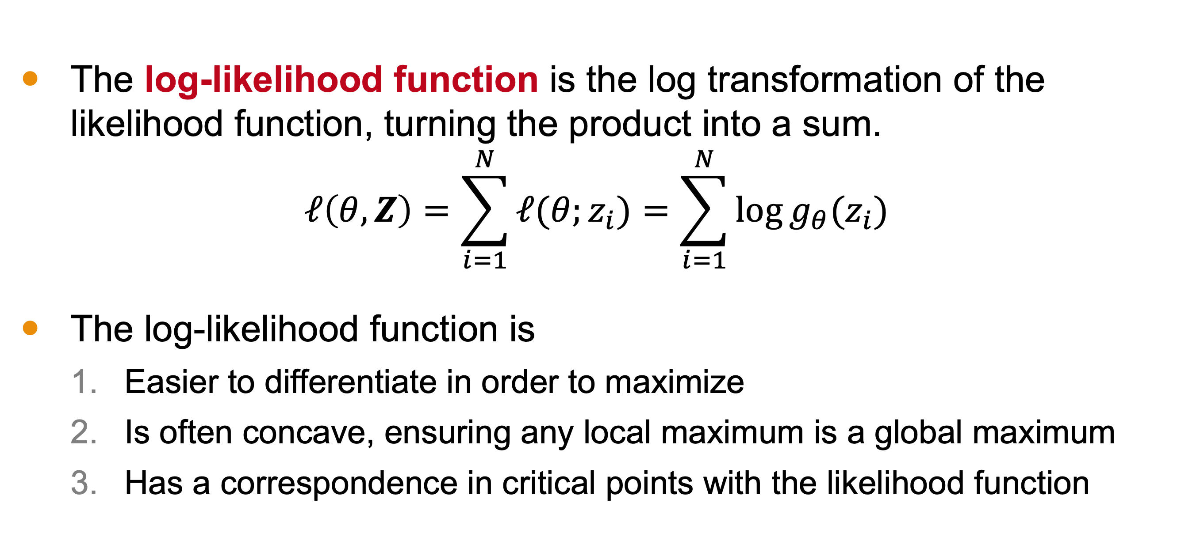
Log-Likelihood Function
The log-likelihood function is the log transformation of the likelihood function, turning the product into a sum.
$$ℓ\left(θ,Z\right)=\sum_{i=1}^{N}{ℓ(θ;z_{i})}=\sum_{i=1}^{N}{\log{g_{θ}(z_{i})}}$$
The log-likelihood function is
Easier to differentiate in order to maximize
Is often concave, ensuring any local maximum is a global maximum
Has a correspondence in critical points with the likelihood function

Slide 11
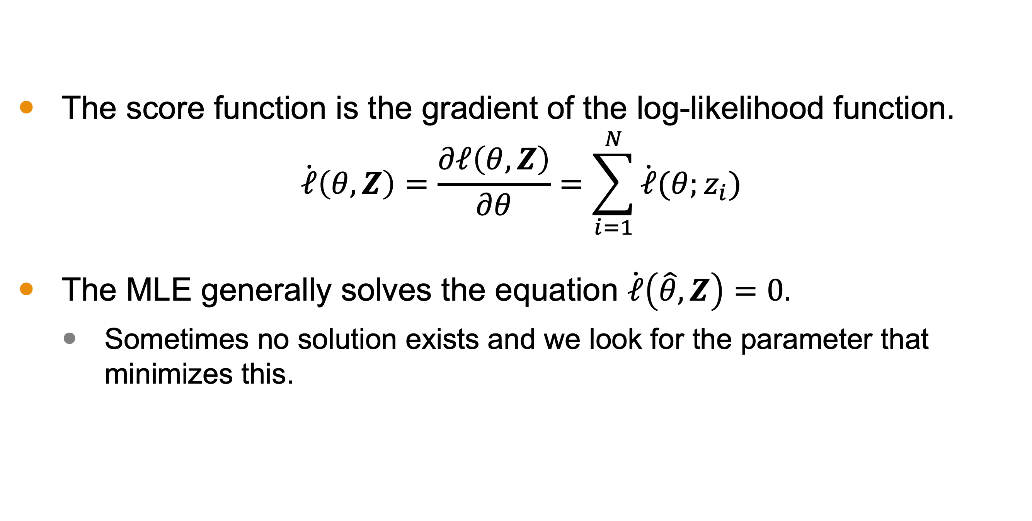
Score Function
The score function is the gradient of the log-likelihood function.
$$\dot{ℓ}\left(θ,Z\right)=\frac{∂ℓ\left(θ,Z\right)}{∂θ}=\sum_{i=1}^{N}{\dot{ℓ}(θ;z_{i})}$$
The MLE generally solves the equation $\dot{ℓ}\left(\hat{θ},Z\right)=0.$
Sometimes no solution exists and we look for the parameter that minimizes this.

Slide 12
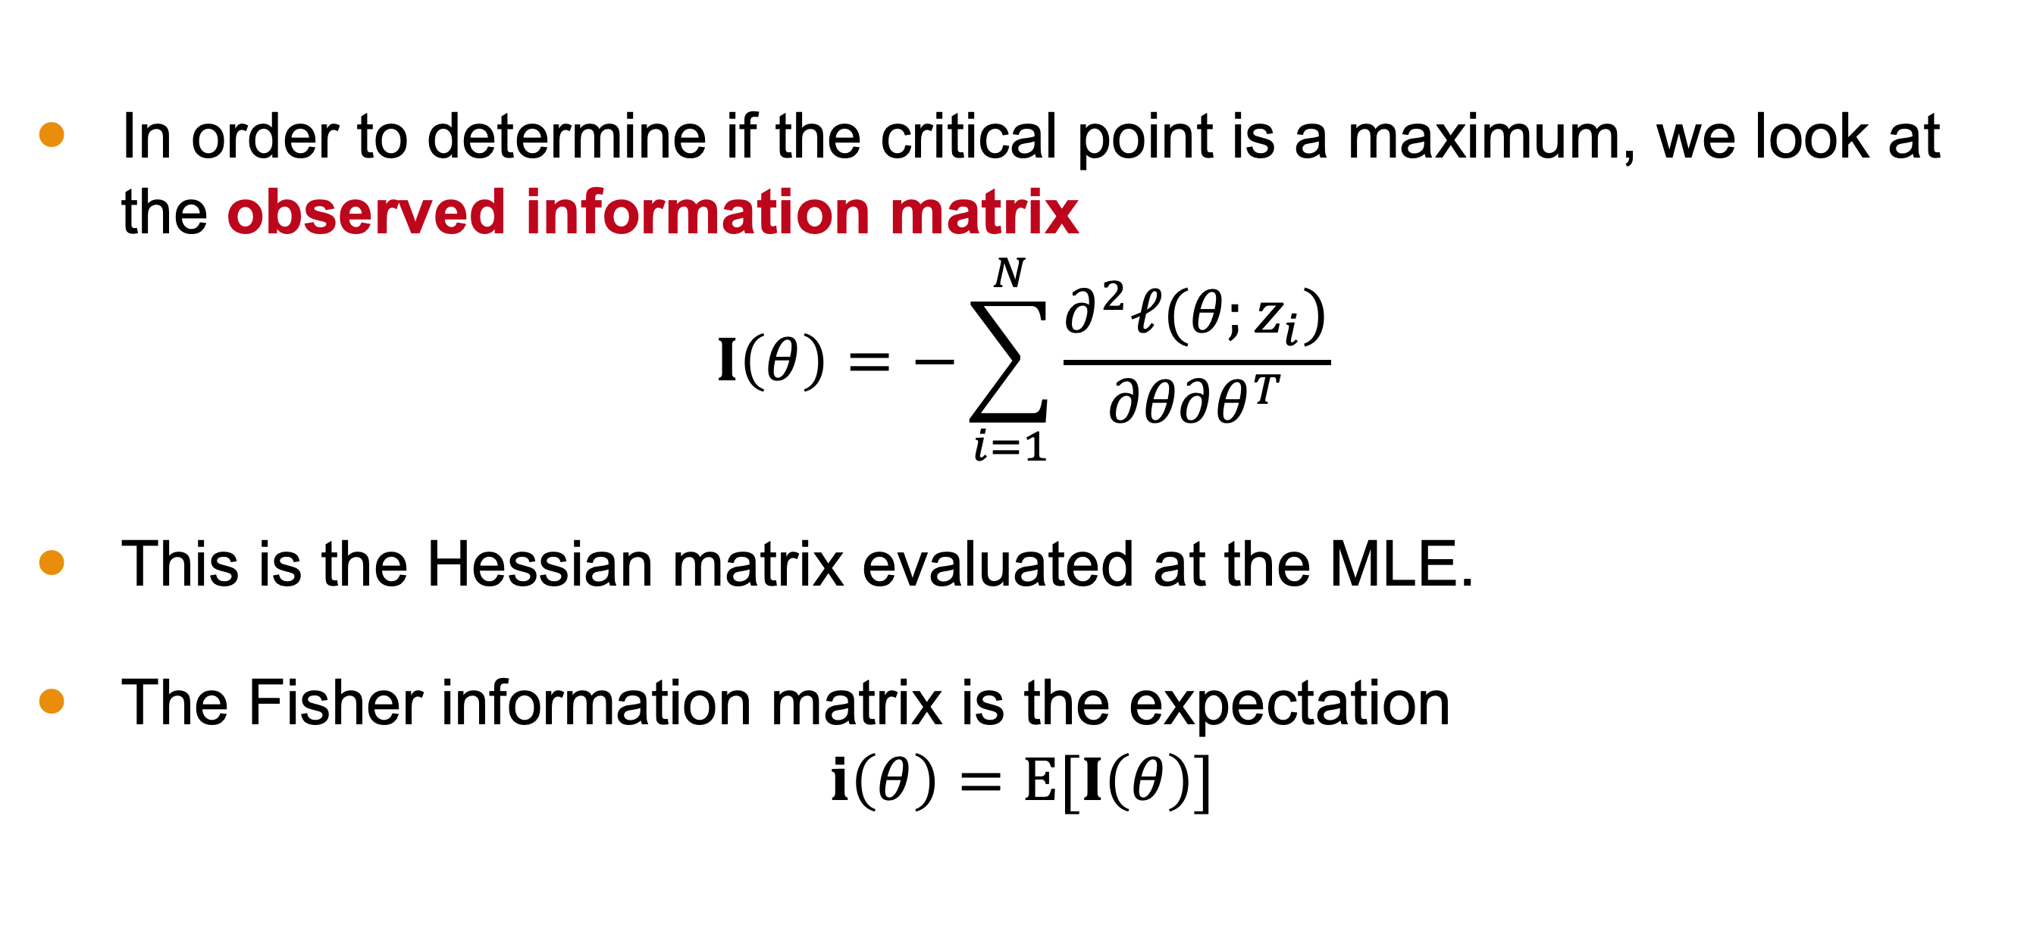
Information Matrix
In order to determine if the critical point is a maximum, we look at the observed information matrix
$$I\left(θ\right)=−\sum_{i=1}^{N}{\frac{∂^{2}ℓ(θ;z_{i})}{∂θ∂θ^{T}}}$$
This is the Hessian matrix evaluated at the MLE.
The Fisher information matrix is the expectation
$$i\left(θ\right)=E[I\left(θ\right)]$$

Slide 13
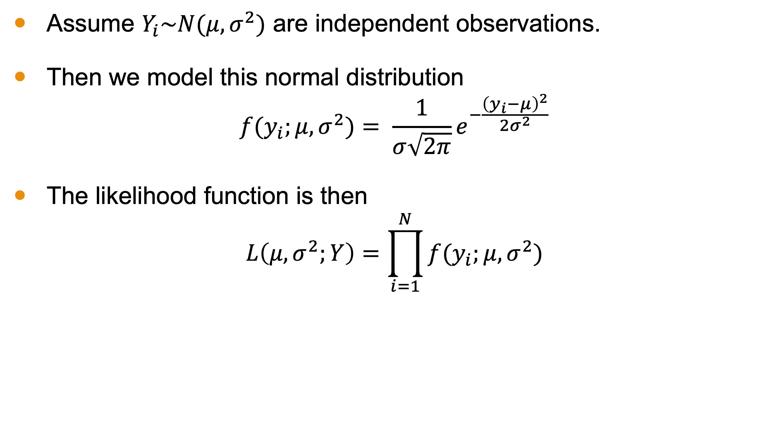
Example 1: Mean and Variance
Assume $Y_{i}\sim N(μ, σ^{2})$ are independent observations.
Then we model this normal distribution
$$f(y_{i};μ, σ^{2})= \frac{1}{σ\sqrt{2π}}e^{−\frac{{\left(y_{i}−μ\right)}^{2}}{2σ^{2}}}$$
The likelihood function is then
$$L\left(μ, σ^{2};Y\right)=\prod_{i=1}^{N}{f(y_{i};μ, σ^{2})}$$

Slide 14
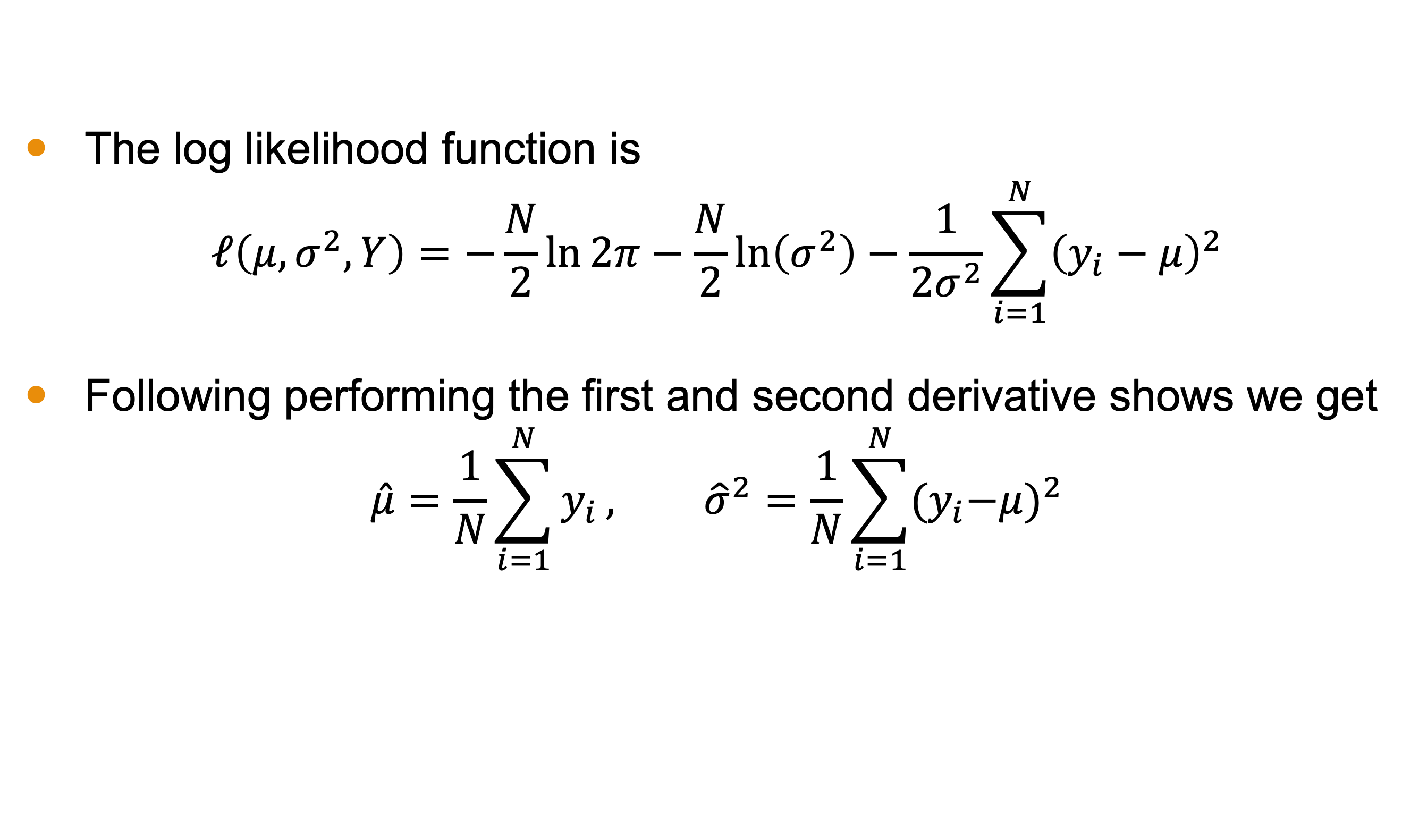
Example 1: Mean and Variance
The log likelihood function is
$$ℓ\left(μ, σ^{2},Y\right)=−\frac{N}{2}\ln{2π}−\frac{N}{2}\ln\left(σ^{2}\right)−\frac{1}{2σ^{2}}\sum_{i=1}^{N}{{\left(y_{i}−μ\right)}^{2}}$$
Following performing the first and second derivative shows we get
$$\hat{μ}=\frac{1}{N}\sum_{i=1}^{N}{y_{i}}, {\hat{σ}}^{2}=\frac{1}{N}\sum_{i=1}^{N}{{{(y}_{i}−μ)}^{2}}$$

Slide 15
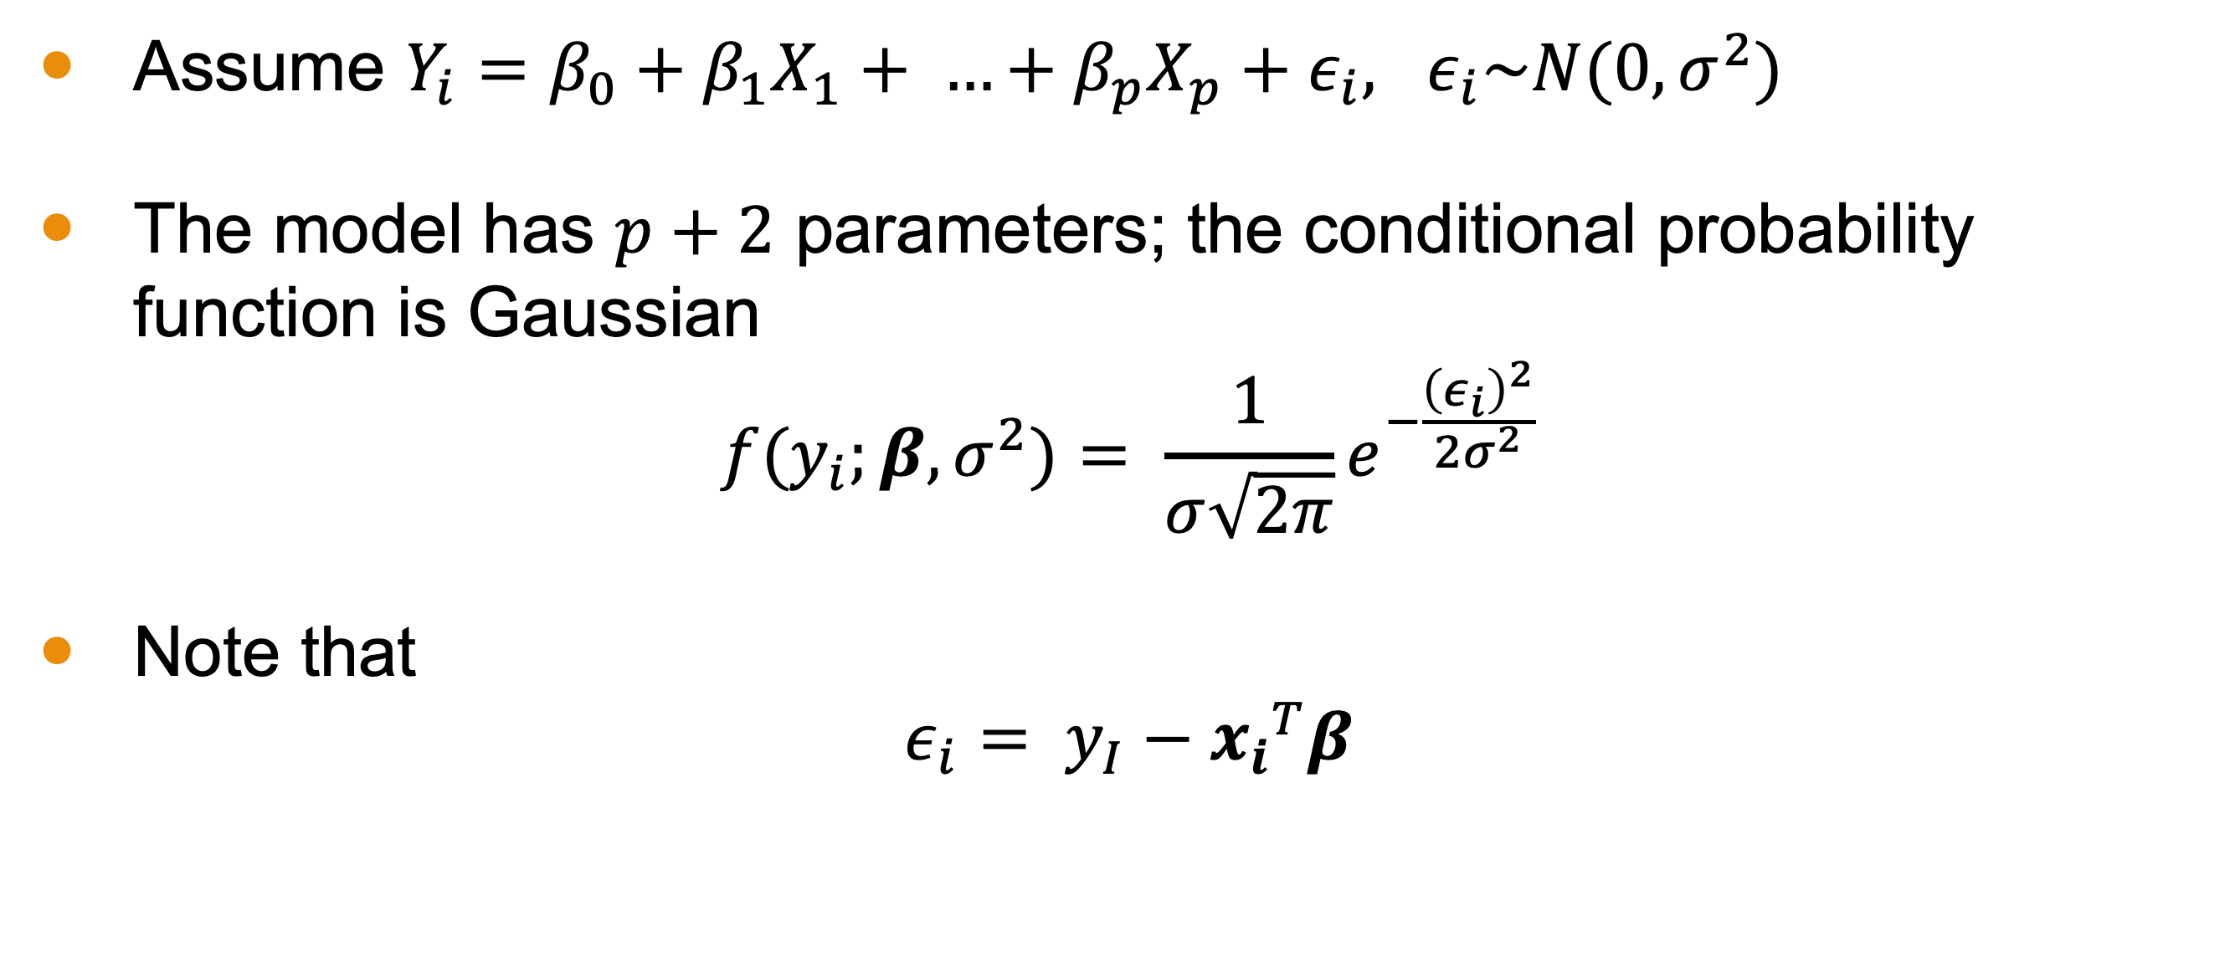
Example 2: OLS Regression
Assume $Y_{i}=β_{0}+β_{1}X_{1}+ …+β_{p}X_{p}+ε_{i}, ε_{i}\sim N(0, σ^{2})$
The model has $p+2$ parameters; the conditional probability function is Gaussian
$$f(y_{i};β,σ^{2})= \frac{1}{σ\sqrt{2π}}e^{−\frac{{\left(ε_{i}\right)}^{2}}{2σ^{2}}}$$
Note that
$$ε_{i}= y_{I}−{x_{i}}^{T}β$$

Slide 16
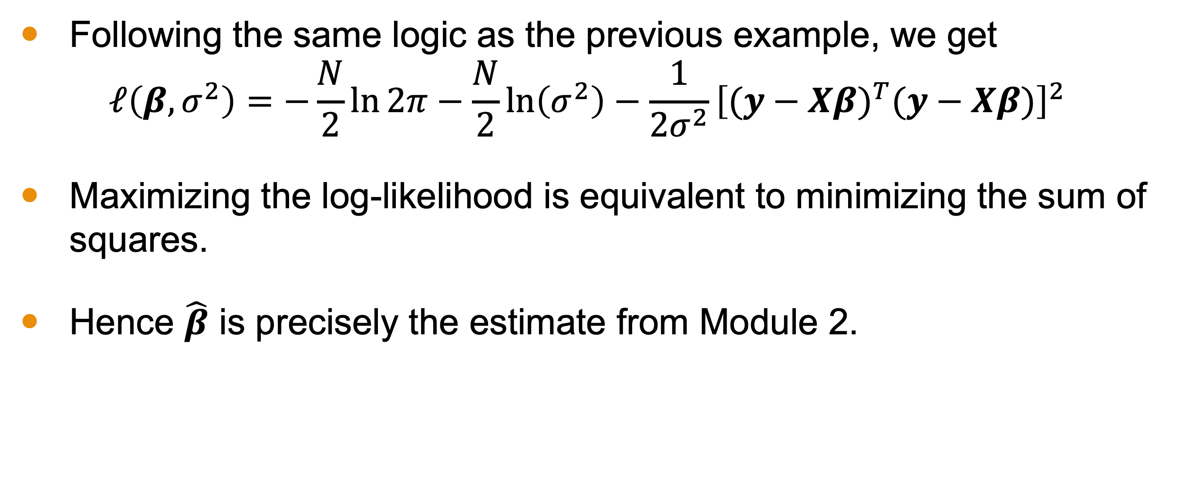
Example 2: OLS Regression
Following the same logic as the previous example, we get
$$ℓ\left(β,σ^{2}\right)=−\frac{N}{2}\ln{2π}−\frac{N}{2}\ln\left(σ^{2}\right)−\frac{1}{2σ^{2}}{\left[{(y−Xβ)}^{T}(y−Xβ)\right]}^{2}$$
Maximizing the log-likelihood is equivalent to minimizing the sum of squares.
Hence $\hat{β}$ is precisely the estimate from Module 2.

Slide 17
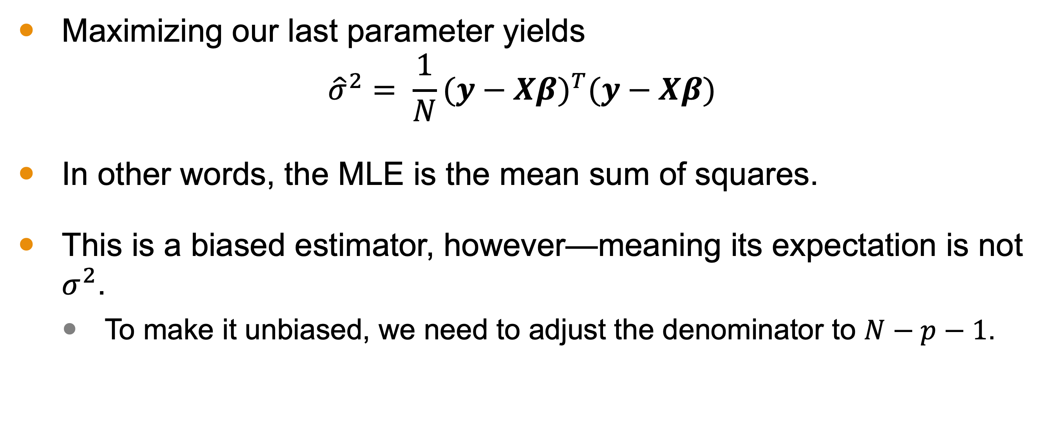
Example 2: OLS Regression
Maximizing our last parameter yields
$${\hat{σ}}^{2}= \frac{1}{N}{(y−Xβ)}^{T}(y−Xβ)$$
In other words, the MLE is the mean sum of squares.
This is a biased estimator, however—meaning its expectation is not $σ^{2}$.
To make it unbiased, we need to adjust the denominator to $N−p−1$.

Slide 18
Conclusion
Maximum likelihood inference is a method of estimating a model’s parameters by maximizing the log-likelihood function.
Philosophically, this selects the parameters for which our dataset is most-likely to get sampled.
We do this by taking the first derivative of the log-likelihood function, find its critical points, and check the Hessian to determine if we have a maximum.

